Slide 1
Multilevel Parking System
Weiming Huang, Kaiyu Lin
English for Engineer
2014.4.14

Slide 2
Preview
Needs Analysis
Decision Introduction
Decision Matrix
Schedule
Conclsion

Slide 3
Needs Analysis
Problem statement: Our university doesn’t have enough parking space in some places in the campus, so many students and teachers are late for class because of looking for parking space. Therefore, we should change some parking areas into multilevel parking system. This system should able to park more cars than before in the same area and work under extremely cold temperatures.

Slide 4
Needs Analysis
Constraints:
1. Lower than 5% of the MTU budget.(8 million dollars)
2. Parking more cars than before.
3. Protect the parking lot from the weather.

Slide 5
Needs Analysis
Criteria:
1. Low cost
2. High efficiency for parking cars.
3. Safety
4. Durable
5. Good appearance

Slide 6
Decision Introduction
Multilevel Parking System:
Save space in Campus
Lowest cost in different choices

Slide 7
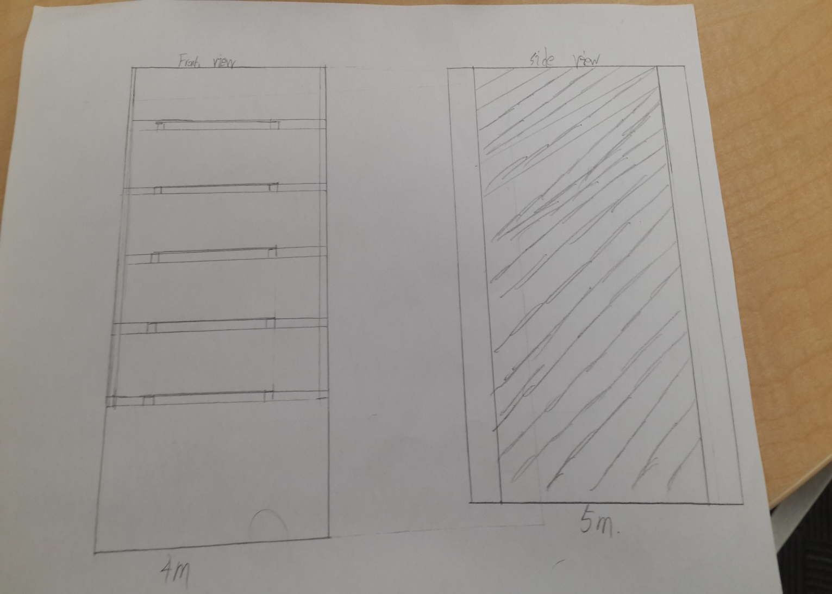
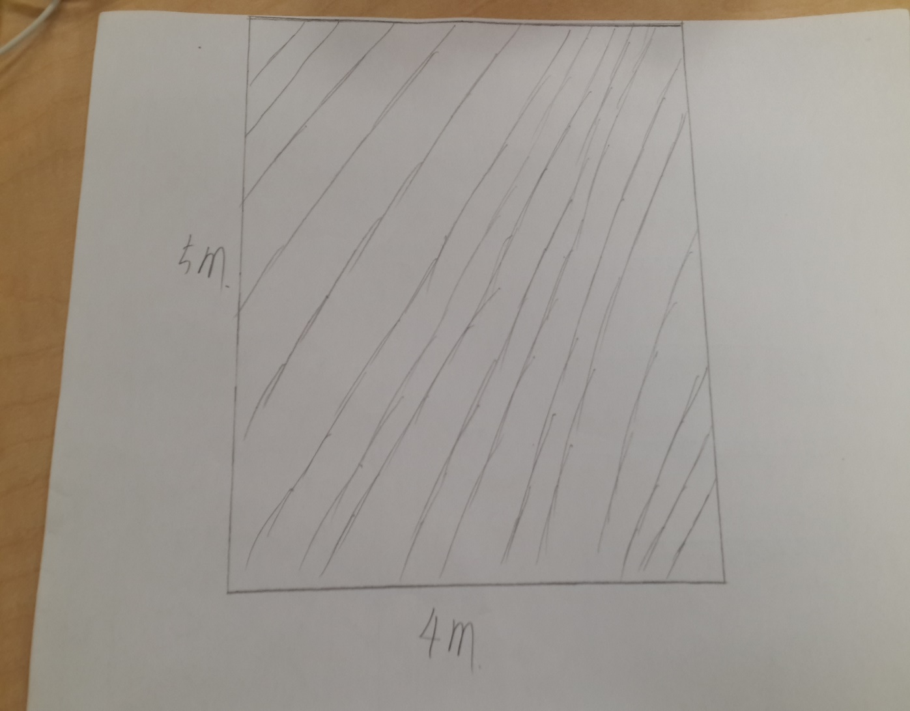
Design

Slide 8
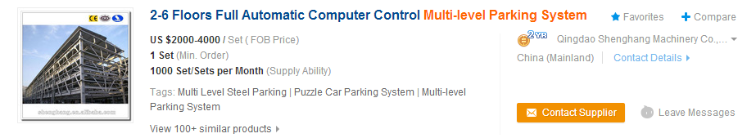
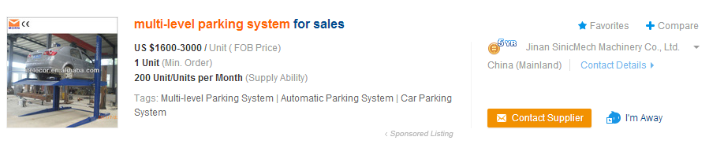
Research
http://www.alibaba.com/showroom/multi--level-parking-system.html

Slide 9
Decision Matrix
Items | Weight | Underground parking | Parking building | Big new parking lots | Multilevel parking
Cost | 30% | 3 | 5 | 7 | 10
Efficiency | 30% | 8 | 8 | 6 | 7
Safety | 20% | 6 | 9 | 10 | 8
Durable | 20% | 9 | 10 | 9 | 9
Final Score | 100% | 630 | 590 | 770 | 850

Slide 10
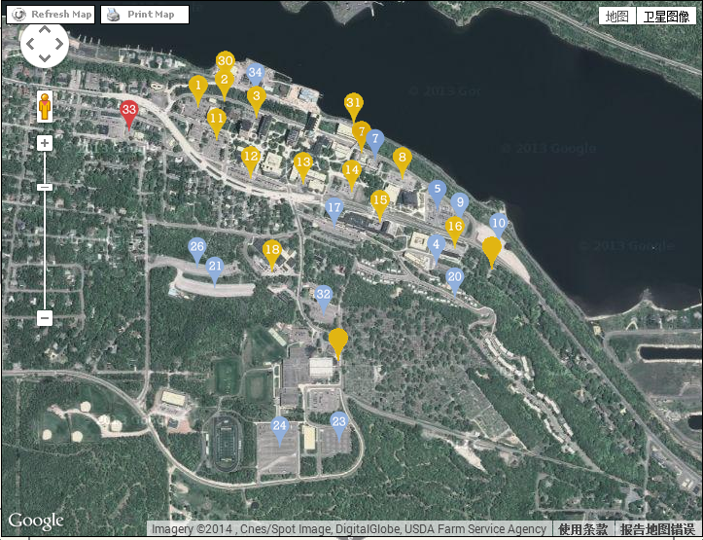
Plan

Slide 11
Schedule
Operate | Time (days)
Order | 30
Assemble | 7
construct | 50
test | 7
total | 94

Slide 12
Cost
One system needs almost 5000 dollars (including assemble and dig a pit for a system), and we have approximately 300 parking lots.
5000 * 300 = 1500000 dollars
Our plan need about 1.5 million dollars.

Slide 13
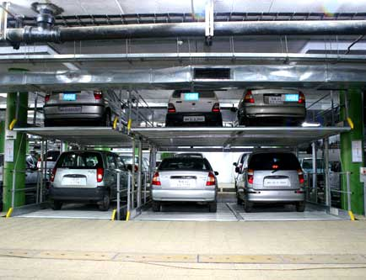
Examples
http://affordmotors.com/images/gallery/parkingyard/3.jpg

Slide 14
Conclusion
Our plan would make more available parking lots , it also would save time for students and teachers.

Slide 15
Thanks for watching
Do you have any questions?

